Slide 1
Malignant Comments Classifier
Submitted by Yashna Shah

Slide 2
Introduction
Over a decade, social media have been growing, and people are able to express their opinions and also discuss among others via these platforms.
These debates may arise due to differences in opinion and may often result in fights over the social media during which offensive language termed as malignant comments may be used from one side.
This clearly pose the threat of abuse and harassment online.
As such, some people stop giving their opinions or give up seeking different opinions which result in unhealthy and biased discussion.
Therefore it results in different platforms and communities finding it very difficult to facilitate fair conversation and are often forced to either limit user comments or get dissolved by shutting down user comments completely.

Slide 3
Problem Statement
The proliferation of social media enables people to express their opinions widely online. However, at the same time, this has resulted in the emergence of conflict and hate, making online environments uninviting for users. Although researchers have found that hate is a problem across multiple platforms, there is a lack of models for online hate detection.
Online hate, described as abusive language, aggression, cyberbullying, hatefulness and many others has been identified as a major threat on online social media platforms. Social media platforms are the most prominent grounds for such toxic behavior.
There has been a remarkable increase in the cases of cyberbullying and trolls on various social media platforms. Many celebrities and influences are facing backlashes from people and have to come across hateful and offensive comments. This can take a toll on anyone and affect them mentally leading to depression, mental illness, self-hatred and suicidal thoughts.
Internet comments are bastions of hatred and vitriol. While online anonymity has provided a new outlet for aggression and hate speech, machine learning can be used to fight it. The problem we sought to solve was the tagging of internet comments that are aggressive towards other users. This means that insults to third parties such as celebrities will be tagged as unoffensive, but “u are an idiot” is clearly offensive.
Our goal is to build a prototype of online hate and abuse comment classifier which can used to classify hate and offensive comments so that it can be controlled and restricted from spreading hatred and cyberbullying.

Slide 4
Dataset Description
The data set contains the training set, which has approximately 1,59,000 samples and the test set which contains nearly 1,53,000 samples. All the data samples contain 8 fields which includes ‘Id’, ‘Comments’, ‘Malignant’, ‘Highly malignant’, ‘Rude’, ‘Threat’, ‘Abuse’ and ‘Loathe’.
The label can be either 0 or 1, where 0 denotes a NO while 1 denotes a YES. There are various comments which have multiple labels. The first attribute is a unique ID associated with each comment.
The data set includes:
- Malignant: It is the Label column, which includes values 0 and 1, denoting if the comment is malignant or not.
- Highly Malignant: It denotes comments that are highly malignant and hurtful.
- Rude: It denotes comments that are very rude and offensive.
- Threat: It contains indication of the comments that are giving any threat to someone.
- Abuse: It is for comments that are abusive in nature.
- Loathe: It describes the comments which are hateful and loathing in nature.
- ID: It includes unique Ids associated with each comment text given.
- Comment text: This column contains the comments extracted from various social media platforms.

Slide 5
Conceptual Background
Online platforms and social media have evolved into places where individuals may freely discuss their beliefs without regard for race, and where people can share their thoughts and ideas with a large group of people. Social media is Internet-based by design, allowing people to share material quickly via electronic means. Personal information, documents, movies, and images are all included in the content. Users interact with social media using web-based software or applications on a computer, tablet, or smartphone. Some people on this massive internet platform or online community wilfully abuse others to prevent them from sharing their thoughts in a proper manner. They use filthy language to intimidate others, which is considered a form of ignominy in civilised society. When innocent people are intimidated by these mobs, they remain mute without saying anything. As a result, the disgusting mob's goal is excellently realised. To address this issue, we are now developing a model that recognises all foul language and foul terms, with the goal of preventing these mobs from using foul language in online communities or perhaps blocking them from using foul language altogether.

Slide 6
Data Science Life Cycle
Will need to follow the complete life cycle of data science that includes steps like –
1. Data Cleaning
2. Exploratory Data Analysis
3. Data Pre-processing
4. Model Building
5. Model Evaluation
6. Selecting the best model

Slide 7
Data Pre-processing
1. Load dataset
2. There were no null values in our dataset.
3. Drop column id
4. Convert comment text to lower case and replace '\n' with single space.
5. Keep only text data ie. a-z' and remove other data from comment text.
6. Remove stop words and punctuations
7. Apply Stemming
8. Convert text to vectors using TfidfVectorizer
9. Saving the model
10. Predict values for multi class labe

Slide 8
Technology Used
Hardware technology being used.
RAM : 16 GB
CPU : 11th Gen Intel(R) Core(TM) i5-1135G7 @ 2.40GHz 2.42 GHz
GPU : intel Iris Graphics Software technology being used.
Programming language : Python Distribution : Anaconda Navigator Browser based language shell : Jupyter Notebook Libraries/Packages specifically being used. Pandas, NumPy, matplotlib, seaborn, scikit-learn, NLTK

Slide 9
Testing of Identified Approach
The complete list of all the algorithms used for the training and testing classification model are listed below:
1) Logistic Regression
2) Random Forest Classifier
3) Ada Boost Classifier
4) K Nearest Neighbors Classifier
5) Decision Tree Classifier

Slide 10
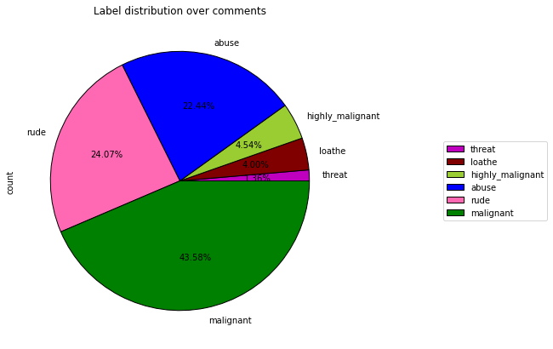
Pie Plots

Slide 11
Observation
Observations: From the pie chart we can notice approximately 43% of the comments are malignant, 24% of the comments are rude and 22% are abuse. The count of malignant comments are high compared to other type of comments and the count of threat comments are very less.

Slide 12
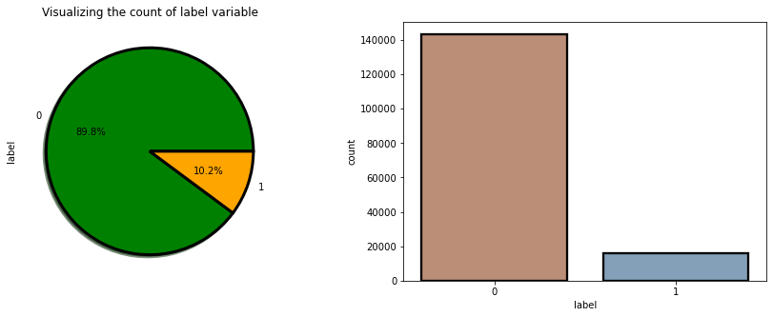
Count of Label Variable

Slide 13
Observations
Observations: From the above plots we can observe the count of negative comments are high compared to the non negative comments. Here around 90% of the comments are turned out to be a negative comments and only 10% of them are considered to be positive or neutral comments. We can also observe the data imbalance issue here, we need to balance the data.

Slide 14
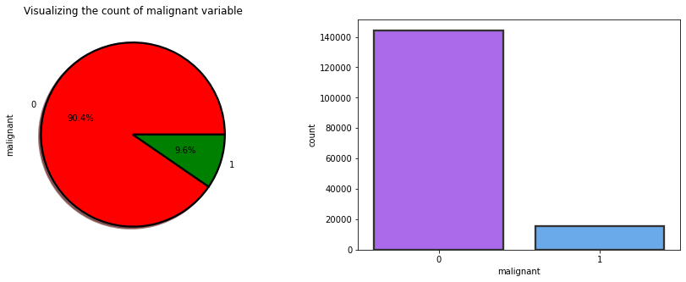
Count of malignant variable

Slide 15
Observations
Observations: From the above plots we can observe the count of malignant comments are high compared to non malignant comments. That is around 90% of the comments are malignant and only 9.6% of the comments are good.

Slide 16
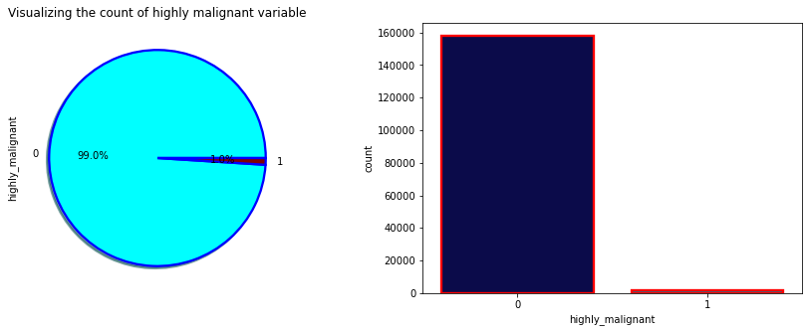
Count of Highly Malignant Variable

Slide 17
Observations
Observations: From the plot we can observe the count of highly malignant comments are very high which is about 99% and only 1% of the comments are normal.

Slide 18
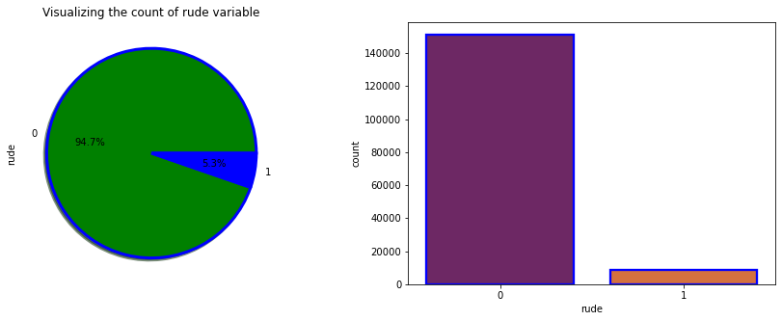
Count of Rude Variable

Slide 19
Observations
Observations: The count of rude comments are high compared to normal comments. Around 94% of the comments are falls down into rude and remaining considered to be normal comments.

Slide 20
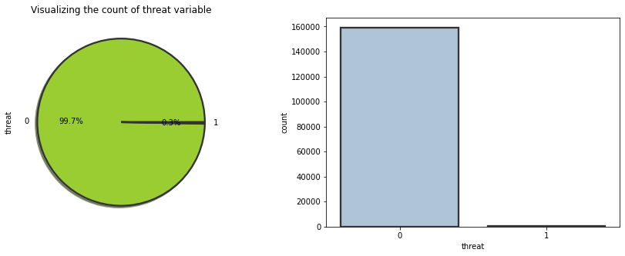
Count of threat variable

Slide 21
Observations
Observations:
Here also 99.7% of the comments are threat and only 0.3% of the comments are look normal.

Slide 22
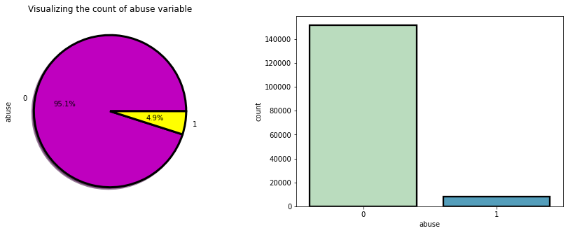
Count of Abuse Variable

Slide 23
Observations
Observations:
The count of abusing type comments are high which has 95.1% and only 4.9% of the comments are normal.

Slide 24
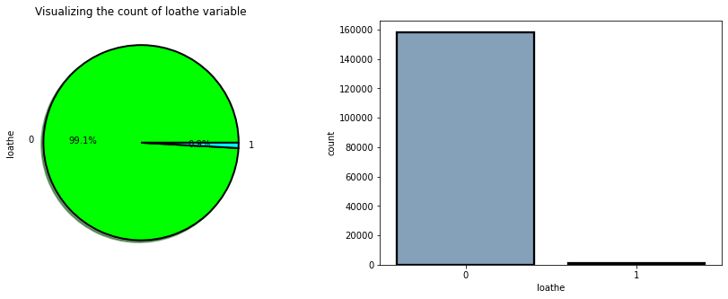
Count of Loathe Variable

Slide 25
Observations
Observations:
The count of loathe is high compared to normal text comments.

Slide 26
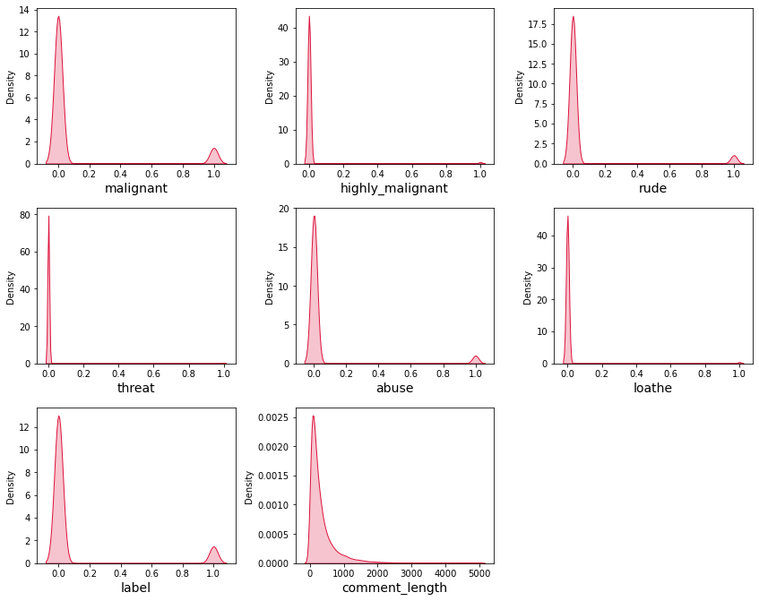
Data Distribution

Slide 27
Observations
Observations:
From the distribution plots we can notice that all the columns are skewned to right except comment_label column. Since all the columns are categorical in nature there is no need to remove skewness and outliers in any of the columns.

Slide 28
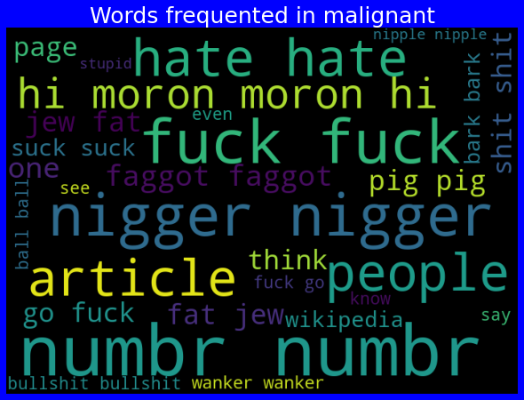
Word Cloud

Slide 29
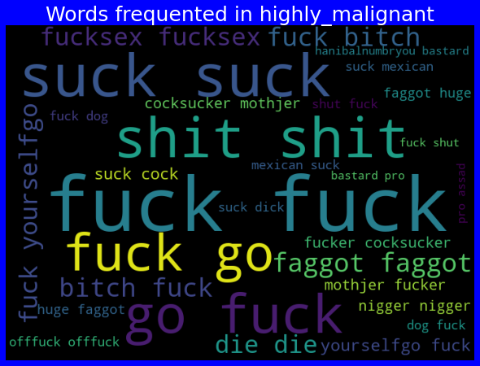
Contd..

Slide 30
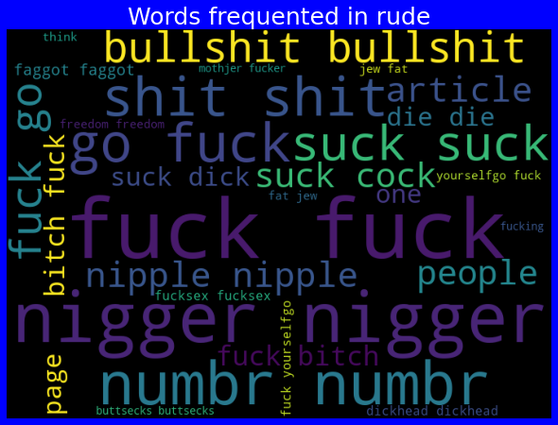
Contd..

Slide 31
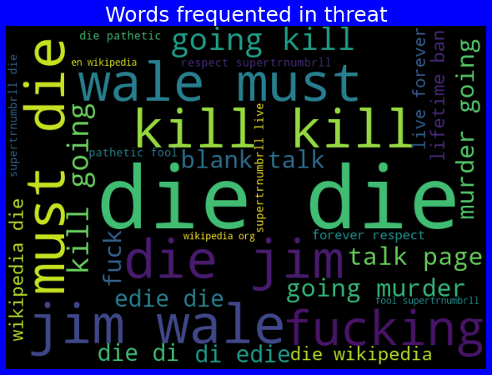
Contd..

Slide 32
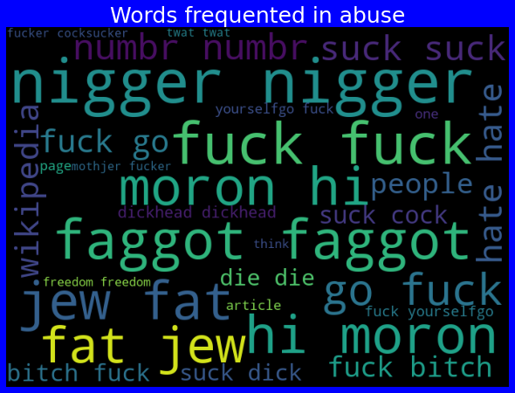
Contd..

Slide 33
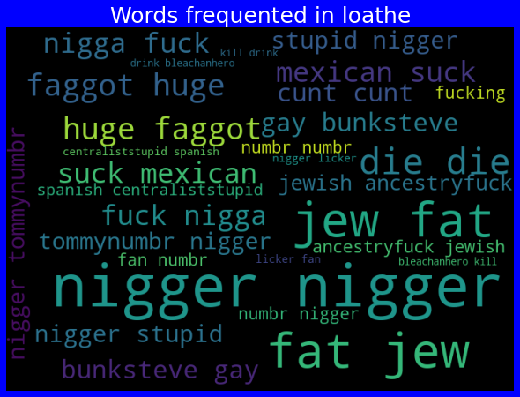
Contd..

Slide 34
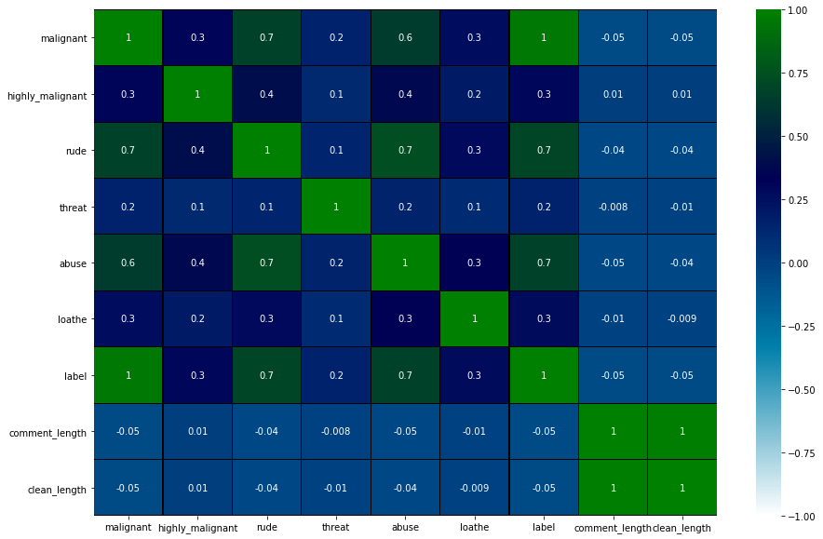
Correlation Matrix

Slide 35
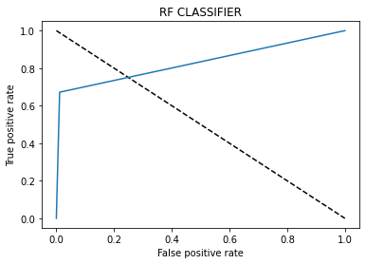
AUC ROC CURVE

Slide 36
Conclusion
The finding of the study is that only few users over online use unparliamentary language. And most of these sentences have more stop words and are being quite long. As discussed before few motivated disrespectful crowds use these foul languages in the online forum to bully the people around and to stop them from doing these things that they are not supposed to do. Our study helps the online forums and social media to induce a ban to profanity or usage of profanity over these forums.

